Slide 1
Make It Shorter
19-124 Jeuk Hwang

Slide 2
What is compression?
compression
decompression

Slide 3
What is compression? - Motivation
Make data smaller by using
resource including time, space
specific rule finding repeated information
Although a known universal compression algorithm is powerful, some specific data with strong rules might be able to compress much more! + like puzzle

Slide 4
Choosing Language
Let’s make puzzle game about compression
what!
why!
But how?

Slide 5
Choosing Language
I can only use Python, JavaScript + no time to run new language
I could not find a safe way to run code in run-time using Python but JS
Find a way to execute code safely while blocking accessing DOM element
Specifically, make Web Worker from string code dynamically in runtime
https://stackoverflow.com/questions/59142946/how-can-i-strictly-limit-scope-within-a-function-or-block

Slide 6
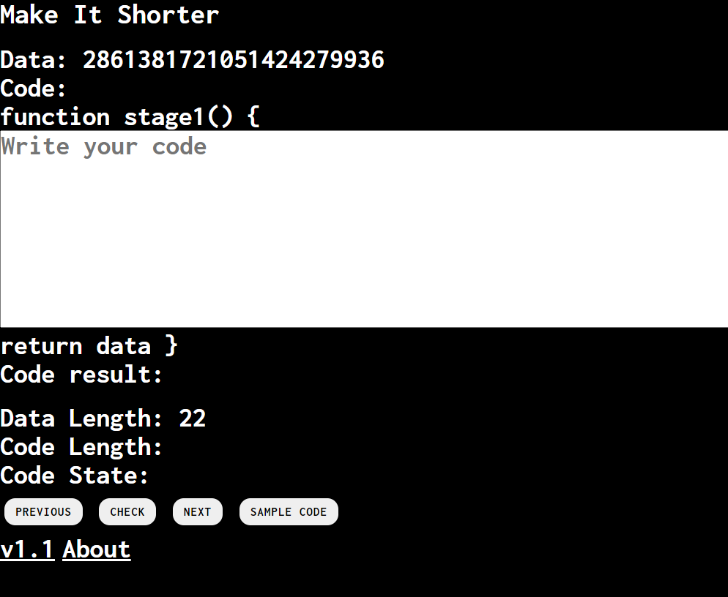
Play
Write shorter JS code than data using mathematic skills or whatever JS glitches
https://github.com/PositivePeriod/MakeItShorter

Slide 7
bundle
(which was called autoforce)
19-124 Jeuk Hwang

Slide 8
Motivation
I just wanted to make game
I considered game about blocking opponent’s selection
I made prototype with A4 paper and played game with friends in dormitory
After 2 hours of playing, several rules were suggested

Slide 9
Finding other game project
I think example.io can be great start for most web game project,
especially multiplayer game using NodeJS, SocketIO
Strongly recommend for people who want to setup development environment
https://github.com/vzhou842/example-.io-game
Since the game is combinatorial game like chess, I try to find some chess projects

Slide 10
Problems…
Want to make the stable game with a database
I never used DB
Since I already used Heroku, I found that Heroku helps clients to use PostgreSQL
To visualize DB, I recommend some GUI tools for DB such as tableplus (having free tier)
especially multiplayer games using NodeJS, SocketIO

Slide 11
What I learned…
Basic SQL grammar
How to setup PostgreSQL in the Heroku project
Elo ranking system for the game
Basic typescript grammar (the project will migrate to TS)
Use of interface such as compatibility
between local DB made by web storage wrapper for development
PostgreSQL wrapper for deployment)

Slide 12
Play
https://bundle-game.herokuapp.com/

Slide 13
Transformation Visualization
19-124 Jeuk Hwang
strongly inspired by Jiwon Lee
(He has his own version)

Slide 14
Content
It visualizes the transformation; $f:ℝ^{2}→ℝ^{2}$
I'm not sure if it is a mathematically exact notation
The code for user-interaction for drawing will be helpful
for whom needs some reference for mouseevent handler
https://github.com/PositivePeriod/Transformation-Visualization
Jiwon said he would try a more game-like approach
https://github.com/jiwon79/smile_transformation

Slide 15
Contact
jeukhwang@gmail.com

