Slide 1
Deeplearn
19-037 박명원

Slide 2
Project
Deep learning model

Slide 3
Why I did this project

Slide 4
What is Deep learning?
Find weight which minimize Loss Function!
0
1
Weight(W)
estimate: [0.8,0.2]
Loss Function
image(input)
Answer label: [1,0]

Slide 5
Loss Function= f(W) → f(W) decrease rapidly if we change W to
-$∇$f(W) direction
W=W -$η∗∇$f(W)
η=learning rate

Slide 7
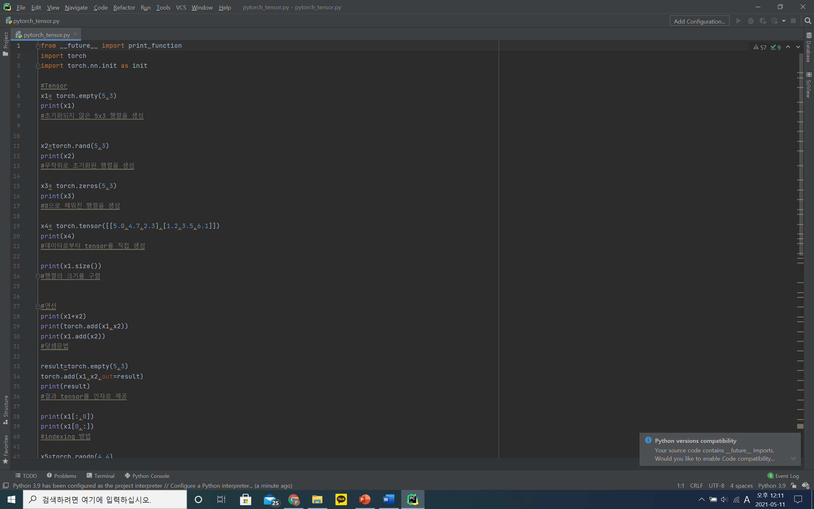
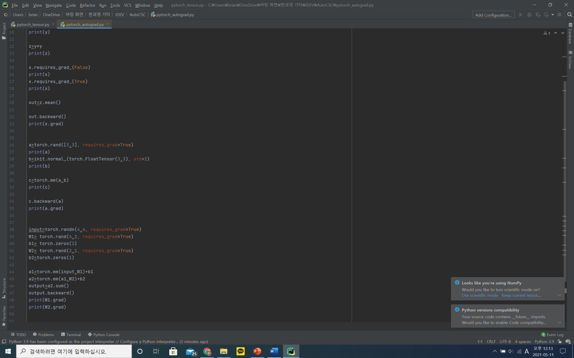

Slide 11
What I learned during doing this project
The effect of data batch
The effect of repeat learning
Coding by using Pytorch

Slide 12
Difficulties
Data loading, Data form
Increasing the accuracy of model
-increasing the number of epoch
-control learning rate
-change the method of renewaling parameter

Slide 13
Imporvements
Accuracy of model
-using batch normalization, dropout
The speed of calculating of model
-using CUDA to increase it

