Slide 2
DoubleCross
19-124 Jeuk Hwang

Slide 3
DoubleCross
| Why I made DoubleCross
Do you know this font?
Times New Roman

Slide 4
DoubleCross
| Why I made DoubleCross
English Redundancy Checker
& Synonym Searcher
For students studying 영어 독해와 작문
including me in 3rd semester
Many friends and I suffered from various errors; format, grammar … and REDUNDANCY

Slide 5
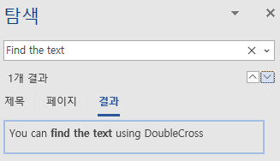
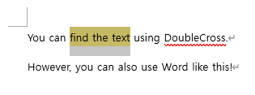
DoubleCross
| Why I made DoubleCross
Format : Copy from last essay, Copy from friends’ essay
Grammar : Use Grammarly, Papago, Google Translator, Ask friends
Redundancy : ??? / You must find every words for finding redundancy words
You can’t know the number of word until searching in most word processor

Slide 6
DoubleCross
| How I made DoubleCross
Pre-survey
Current features in Word, Other people’s program
How can I make?
What should I learn?

Slide 7
DoubleCross
| How I made DoubleCross
2. Thinking Deeply & Extend features - Asking yourself what do users need?
Q. The way to find the specific text from the essay
Python + Libraries, regex 정규표현식
Q. The way to notice the result to users effectively – How to make GUI?
Refer from Microsoft Word and Grammarly’s UI
Q. What do I need to do after finding overlapped words?
Find and replace the words with synonyms
It must be useful having dictionary features
Ask AGAIN - What do I need for making dictionary features?
Q. Python library nltk about natural language processing 자연어처리

Slide 8
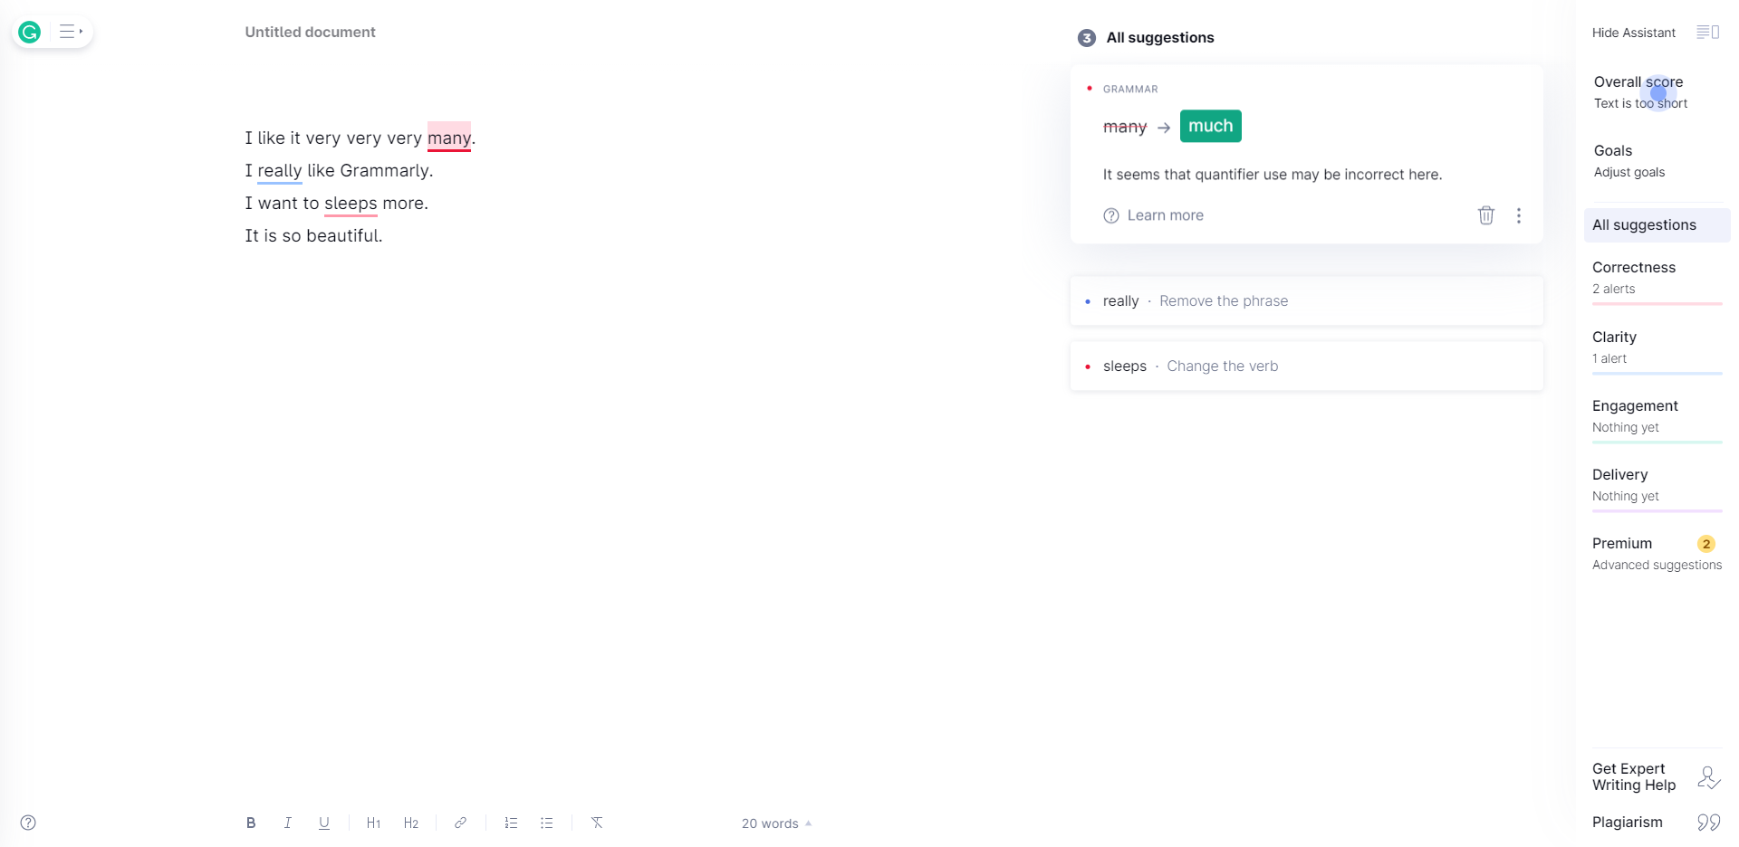
DoubleCross
| How I made DoubleCross
Grammarly’s UI

Slide 9
DoubleCross
| Requirements & Sources
Based on Python 3
GUI : PyQt5
English Redundancy Checker : nltk
Data for synonym source: https://www.thesaurus.com/

Slide 10
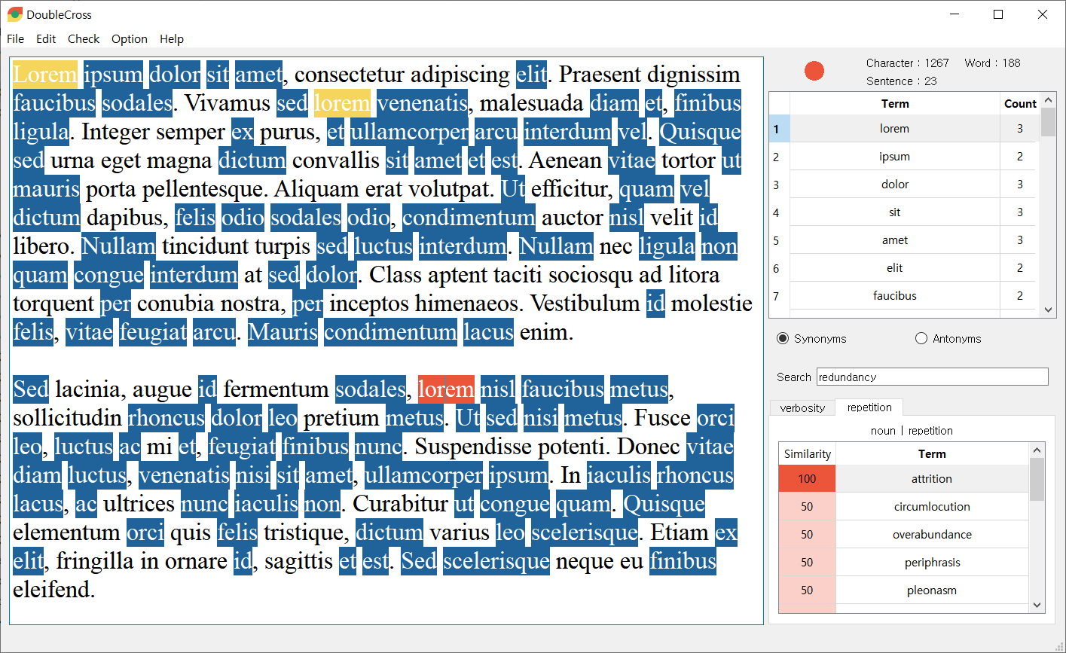
DoubleCross
| Demo
Show overlapped words
List overlapped words
Verb fly VS Noun fly
It knows the difference!
But not perfectly
Dictionary

Slide 11
DoubleCross
| Installation & Contact
How can I use DoubleCross?
Find the download link from Gaonnuri 자유게시판
Download the latest version of DoubleCross
Unzip the file and run DoubleCross.exe
Contact me for any questions, issues and suggestion
Email: positiveperiod.dev@gmail.com
For more information
Github : https://github.com/PositivePeriod/DoubleCross
Gaonnuri : https://gaonnuri.ksain.net/xe/board_free/447261
Youtube : https://www.youtube.com/watch?v=02-ZA7bfBIg

Slide 12
DoubleCross
Thank you for listening

Slide 13
Times New Roman
Noto Sans CJK KR Regular

