Slide 1
Mango, an Online Zamong!

Slide 2
Contents
Introduction
Plan
So far
From now on

Slide 3
introduction
The original Zamong file was rigid:
not flexible on subject change
not flexible on ECs
cannot share schedules online
cannot see the file in different devices
not flexible on International/Korean students’ schedules
So… Let’s make a server to contain it!
we can maintain the server by changing subject data in real time!
now the limit of saving in files in local directory will be solved!
and also more user-friendly!

Slide 4
plan
Online Zamong – Mango! with Django framework
Basically moving the Zamong file to online server with:
flexible subject data(we can change it with administrator account)
sharable schedule by encoding into string
saving data in server
major/minor changes in UI
Hosting with PythonAnywhere

Slide 5
so far...
User
you_are (CharField)
lang (CharField)
SubjectSelect
Subject (ForeignField)
semester (IntegerField)
Subject
subject_nameEN subject_nameKR (CharField)
subject_id (CharField)
SubjectSelect (ManyToManyField)
grade (CharField, choices)
subject_isAP subject_isEC (BooleanField)
subject_credit (IntegerField)
subject_linked (ManyToManyField)
subject_division (ForeignField)
Division
division_name (CharField)
division_id (CharField)
we learned Django
back-end by Django
almost done

Slide 6
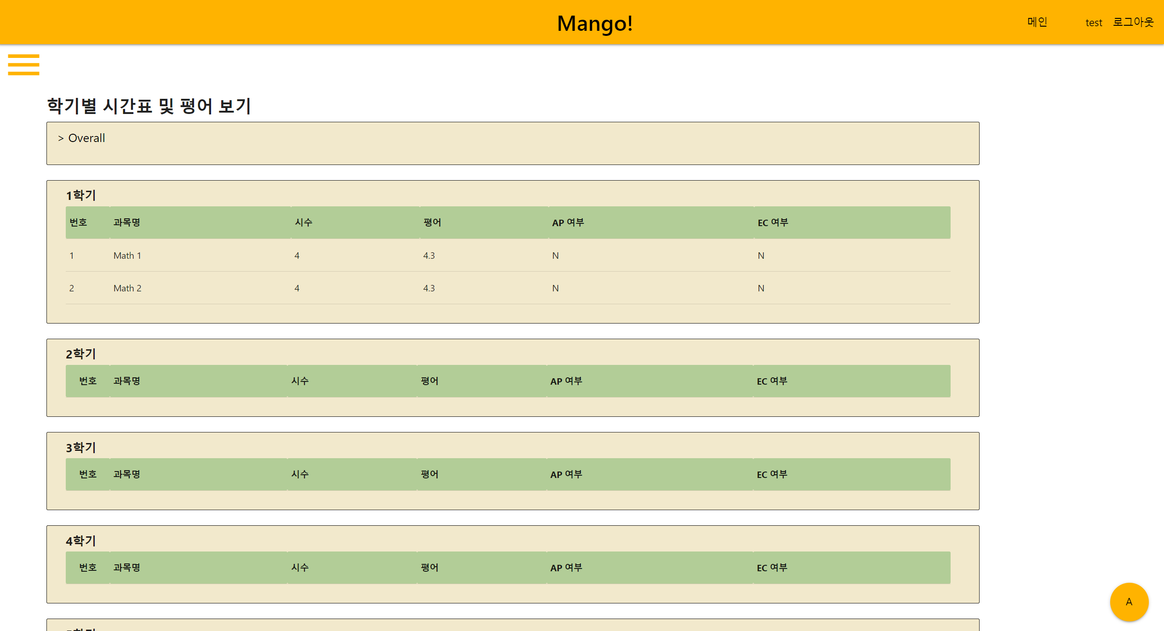
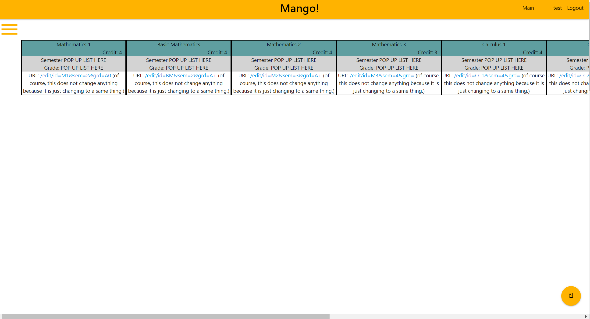
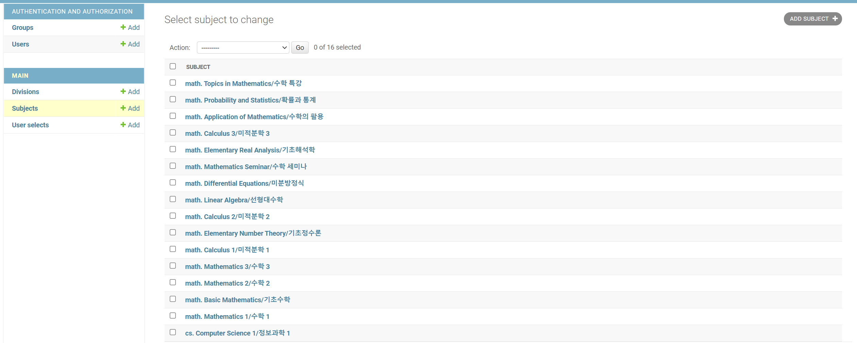
so far...

Slide 7
from now on...
front-end: how to show the scheduler?
hierarchical structure is not that easy to make…
front-end: how to show the overall schedule?
front-end?: how to change user data without refreshing?
front-end?: how to change EN/KR without refreshing?

