Slide 1
IDEV POW Mid-Presentation
19-124 황제욱
20-061 송기원
20-109 조영서
Special Thanks to 19-023 김유신, 19-035 문지환

Slide 2
Contents
Conception and purpose of POW
1st POW : Get as many tissues as you can
2nd POW : Flood-it
Further Plans

Slide 3
1. Conception and purpose of POW
Raise interest in algorithms by introducing interesting problems
Problems that people who are not familiar to CS can also try
Introduce the solution algorithm at the next POW

Slide 4
2. 1st POW : Get as many tissues as you can
Attached to the toilet door of dormitory
※Special Thanks to
권순호, 김준희, 예상우, 황제욱, 문지환, 김병권, 송기원, 김예린

Slide 5
2. 1st POW : Get as many tissues as you can
<예시>
휴지의 최대 개수 : 3+5+(-4)+2+3=9개
최대로 얻기 위한 경로 : DDDRRR
(R : 오른쪽으로 한 칸, D : 아래로 한 칸)
S | 2 | -1
3 | 1 | -2 | 4
5 |  | 3 | 1
-4 | 2 | 3 | E
S
↓
↓
→ | → | → | E
<Example>
Maximum tissue : 3+5+(-4)+2+3=9
최대로 얻기 위한 경로 : DDDRRR
(R : One move to right, D : One move to down)
※ Stop when number of tissue becomes 0

Slide 6
2. 1st POW : Get as many tissues as you can
예제 1 (10점)
예제 2 (20점)
예제 3 (40점)
예제 4 (80점)
S | 3 | -1 | -3 | 5
-3 |  | 2 |  | 2
2 |  | 4 | -1 | 3
5 | -2 | 3 | 1 | 4
 | 1 | 1 | 2 | E
S | 1 | -3 | 1 | 2 | 6
5 | 2 | -3 |  | 3 | -3
3 | -1 | -4 | 2 | 4 | 5
-6 | 3 | 2 | -5 | 3 | -2
4 |  |  | 1 | 0 | 3
5 | 2 | -3 | 4 | 2 | E
S | 6 | 4 | -10 | -4 | -7 | -1
-1 | 5 | 3 |  | -9 | 4 | 6
2 | 9 | 7 | -9 | -10 | -2 | 6
3 | -8 | -2 | -6 | 1 |  | 8
 | 4 | -6 | -1 | 1 |  | 6
-7 | -6 | 4 | 9 | -9 | 3 | 2
1 | 10 |  | 5 | -6 | 8 | E
S | -12 | 14 | 3 | 11 | -10 | 5 | 13 |  | -11 | 1 | -4
12 | -8 | -4 | 12 | -8 | -4 | -13 | 12 | 0 | 1 | 10 | 1
9 | 5 | 6 |  | 5 | 4 | -1 | 13 | 1 | -7 | 9 | 13
1 | -7 | 9 |  | 13 | 3 | 4 | 9 | 1 | 7 |  | 3
-5 | 9 | -11 | -1 | -14 | 1 | -2 | 4 | -5 | -3 | -9 | 4
 | 5 | 6 | -2 | 15 | 12 | -11 | 1 | 2 | -9 | 6 | -2
13 | -13 | 4 | 11 | 2 | 5 | -12 |  |  | 7 | -9 | 3
6 | -14 | 13 | 8 | 10 | 0 | 3 | 6 | 13 | -12 | 4 | 1
-8 | -7 |  | 9 | -8 | 7 | 1 | 5 | 2 | -1 | -10 | -5
3 | 6 | -6 | -1 | -12 | -1 | 8 | 7 | -12 | 5 | -4 | -2
-4 | 3 | 8 | 13 | -1 | -4 | 12 | -8 | -11 | -15 | 0 | -13
9 | 3 | 5 | 4 | 8 |  | 2 | 0 | 7 | 6 | 12 | E

Slide 7
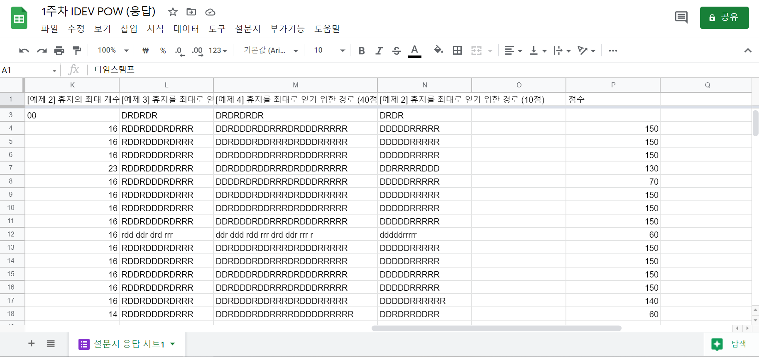
2. 1st POW : Get as many tissues as you can

Slide 8
3. 2nd POW : Flood-it
Introducing the solution algorithm of 1st POW : Dynamic Programming
D[x][y] = max(D[x][y-1] , D[x-1][y]) + A[x][y]
S | 3 | -1 | -3 | 5
-3 |  | 2 |  | 2
2 |  | 4 | -1 | 3
5 | -2 | 3 | 1 | 4
 | 1 | 1 | 2 | E
0 | 3 | 2 | -1 | 5
-3 |  | 4 |  | 2
2 |  | 8 | -1 | 3
5 | -2 | 3 | 1 | 4
 | 1 | 1 | 2 | E
0 | 3 | -1 | -3 | 5
-3 |  | 2 |  | 2
2 |  | 4 | -1 | 3
5 | -2 | 3 | 1 | 4
 | 1 | 1 | 2 | E
0 | 3 | -1 | -3 | 5
-3 |  | 2 |  | 2
2 |  | 4 | -1 | 3
5 | -2 | 3 | 1 | 4
 | 1 | 1 | 2 | E
0 | 3 | 2 | -3 | 5
-3 |  | 2 |  | 2
2 |  | 4 | -1 | 3
5 | -2 | 3 | 1 | 4
 | 1 | 1 | 2 | E
0 | 3 | 2 | -1 | 5
-3 |  | 4 |  | 2
2 |  | 4 | -1 | 3
5 | -2 | 3 | 1 | 4
 | 1 | 1 | 2 | E
0 | 3 | 2 | -1 | 5
-3 |  | 4 |  | 2
2 |  | 8 | 7 | 3
5 | -2 | 11 | 1 | 4
 | 1 | 1 | 2 | E
0 | 3 | 2 | -1 | 5
-3 |  | 4 |  | 2
2 |  | 8 | 7 | 10
5 | -2 | 11 | 12 | 4
 | 1 | 12 | 2 | E
0 | 3 | 2 | -1 | 5
-3 |  | 4 |  | 2
2 |  | 8 | 7 | 10
5 | -2 | 11 | 12 | 16
 | 1 | 12 | 14 | E

Slide 9
3. 2nd POW : Flood-it

Slide 10
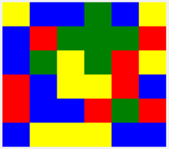
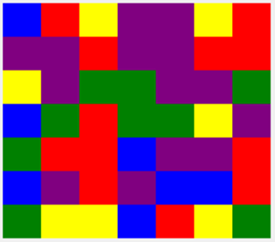
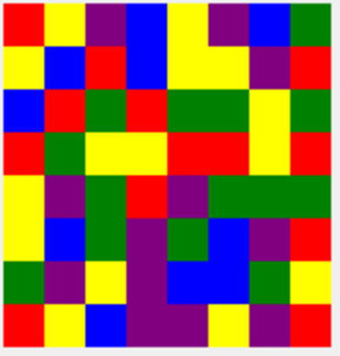
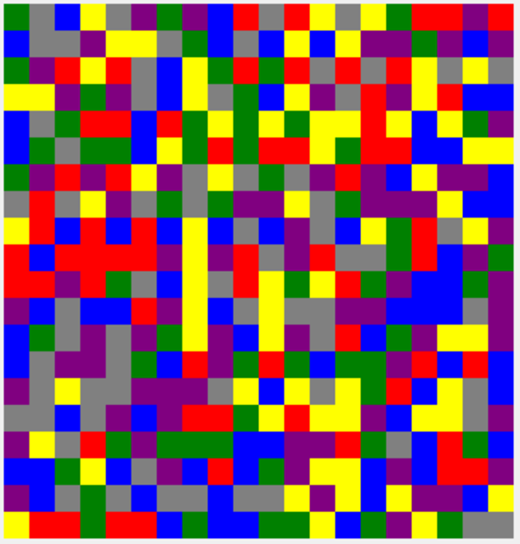
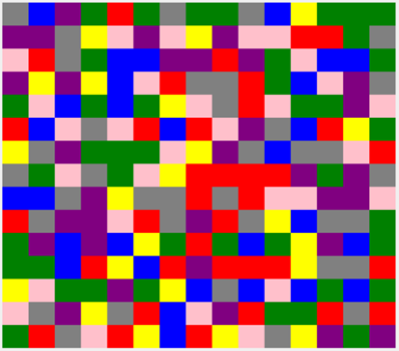
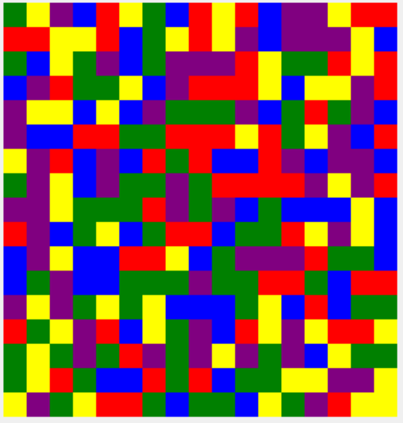
3. 2nd POW : Flood-it
Link
예제 1(10점)
예제 2(20점)
예제 3(30점)
예제6(70점)
예제4(40점)
예제5(50점)

Slide 11
4. Further Plans
Adjust the difficulty appropriately

