Slide 1
KSA Labyrinth : The Truth SAF Quidditch project

Slide 2
2021 SAF Project
https://saf2021.netlify.app/intro

Slide 3
Motivation
The original SAF Quidditch : Treasure Hunt
Online treasure hunt? => Labyrinth(online puzzle)

Slide 4
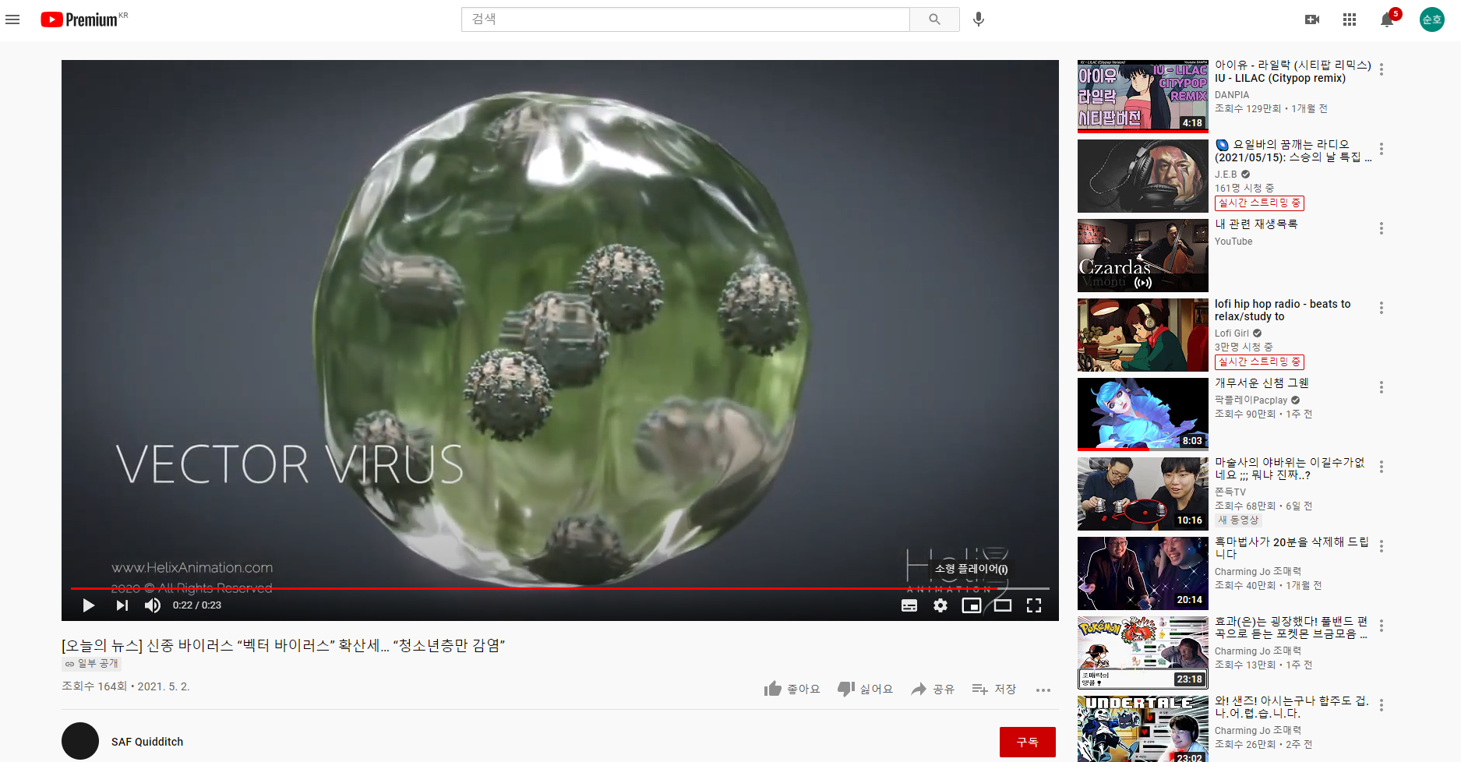
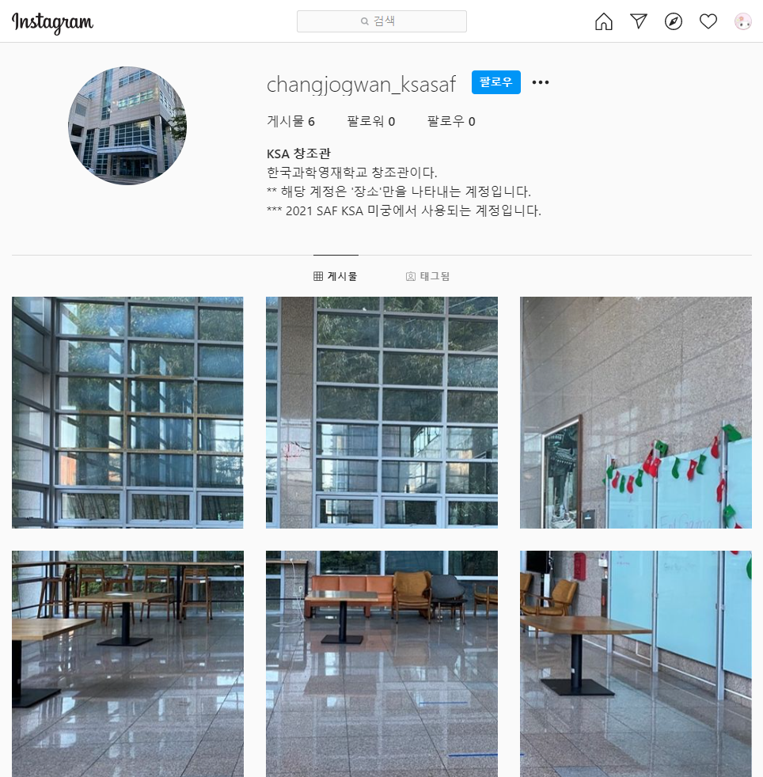
Concept
Redirections to multiple websites

Slide 5
Develop process
Limited time : ~5 days
=> Static website

Slide 6
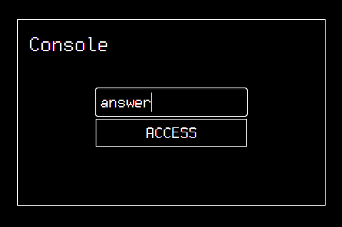
Develop process
Handling answers?
JavaScript => can see source
Web request => static web
Used website directory
https://saf2021.netlify.app/answer

Slide 7
Future Plans
Remake/Rebuild into a independent labyrinth website
Using dynamic web
-> more secure answer handling
-> additional features (ex: login, leaderboard)

Slide 8
Questions?

