Slide 1
KSAlib
19-058 예상우

Slide 2
Motivation
KSA does not have any official APIs
It is very hard to make anything that integrates with websites from KSA
Let’s make a python wrapper for KSA!

Slide 3
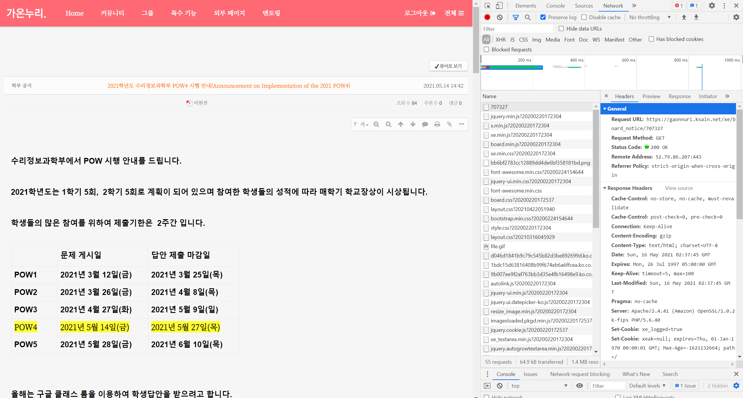
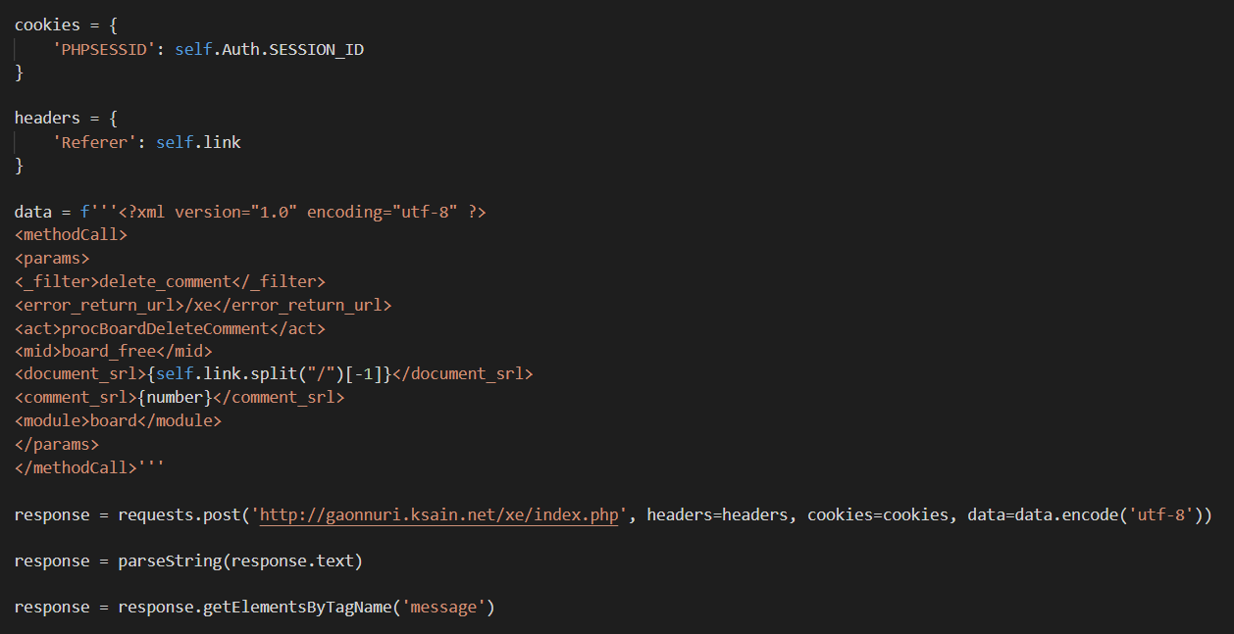
Motivation
이후에 한과영에서의 정보가 필요한 프로그램을 만들 때 훨씬 쉽고 편하게 만들 수 있음!

Slide 4
How it works…
Auth
Performs logins of many websites
Contains all information about a gaonnuri board including post classes
Board :
gaonnuri
Contains all information about a gaoonnuri post, including comments
Post :
Divide into 5 parts
student
Scores, 상벌점, etc
contains all classes of a teacher
lms
Teacher :
contains all information about a class, including posts
Class :
extra

Slide 5
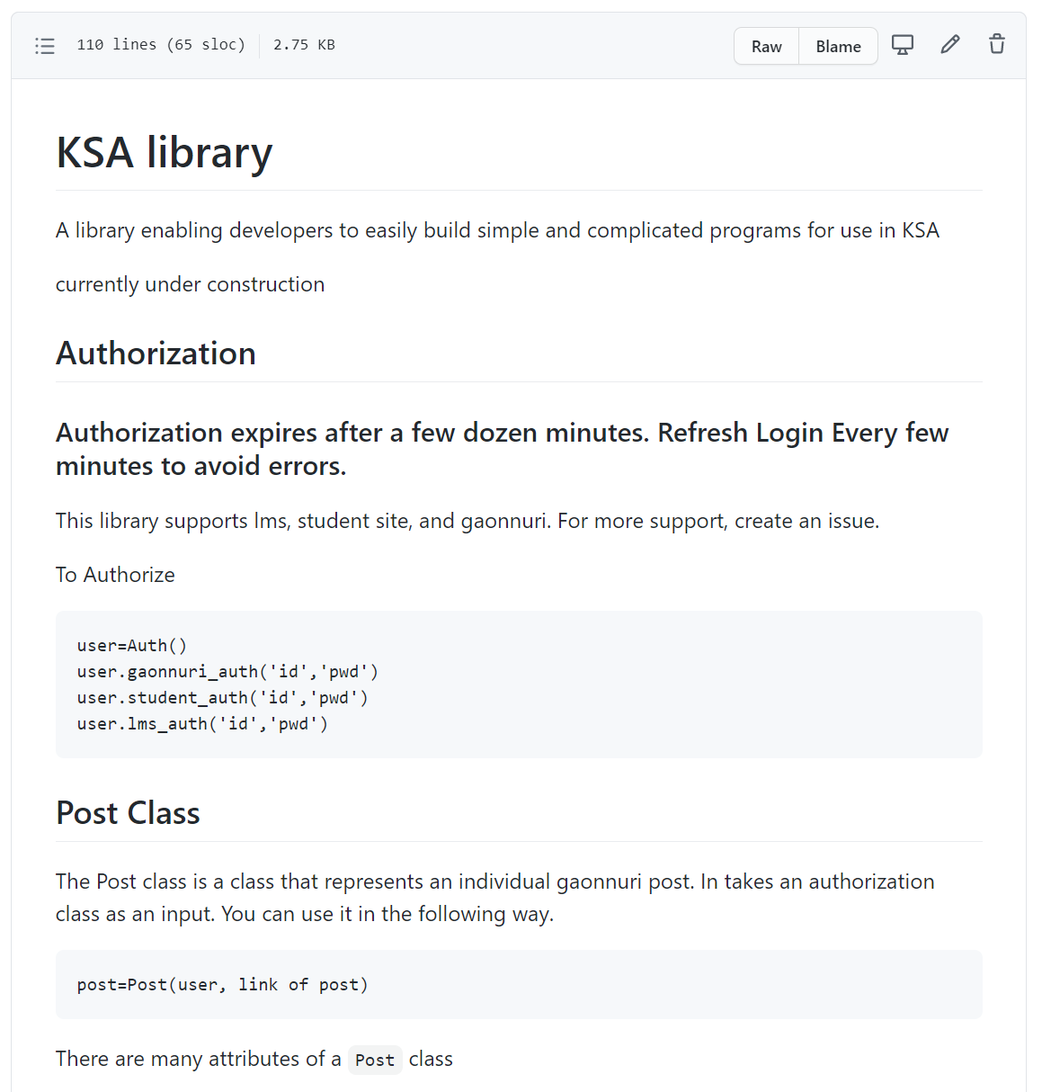
How to use it (not complete)
https://github.com/ksaidev/ksalib/blob/master/README.md

Slide 6
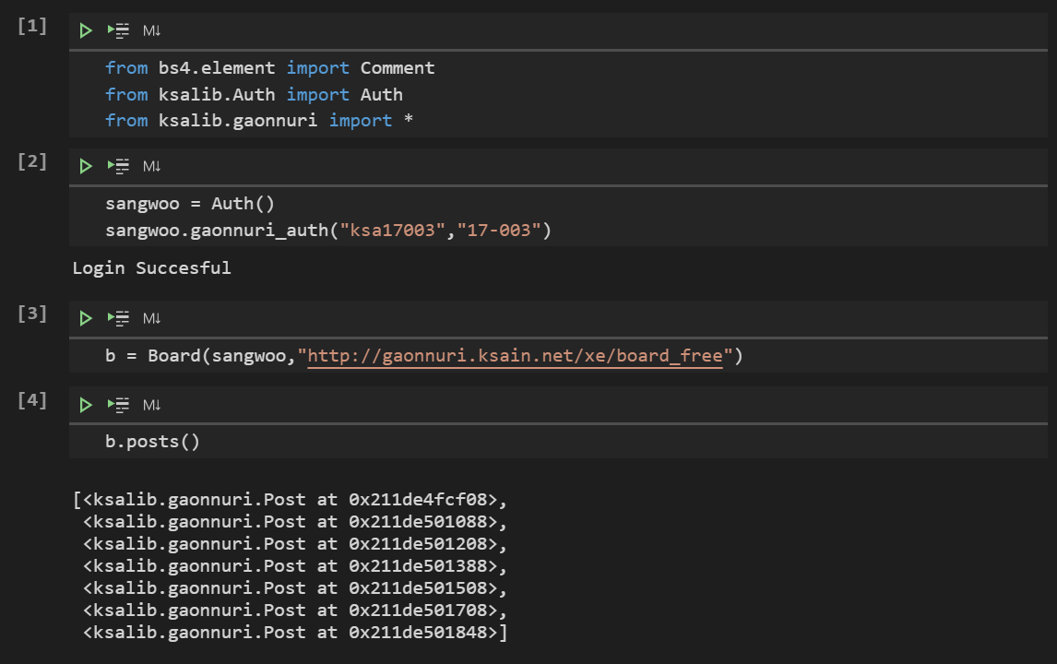
Demo

Slide 7
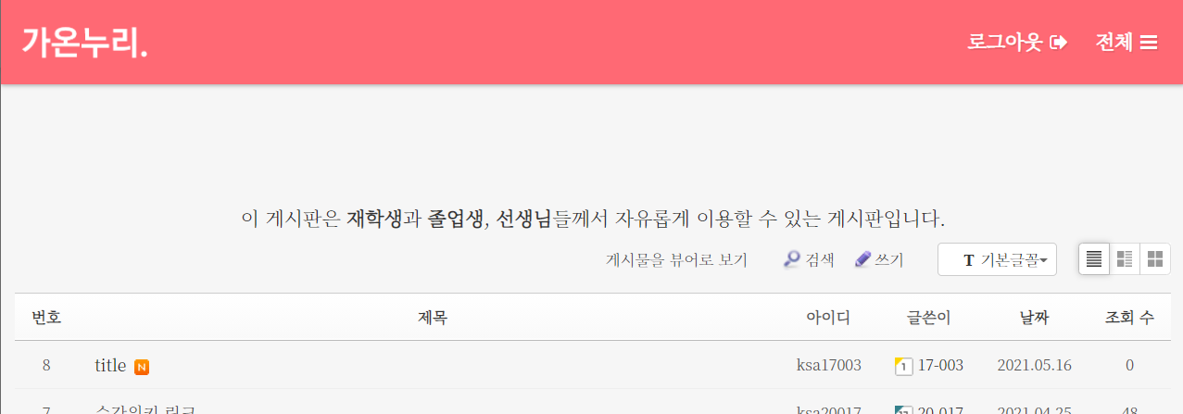
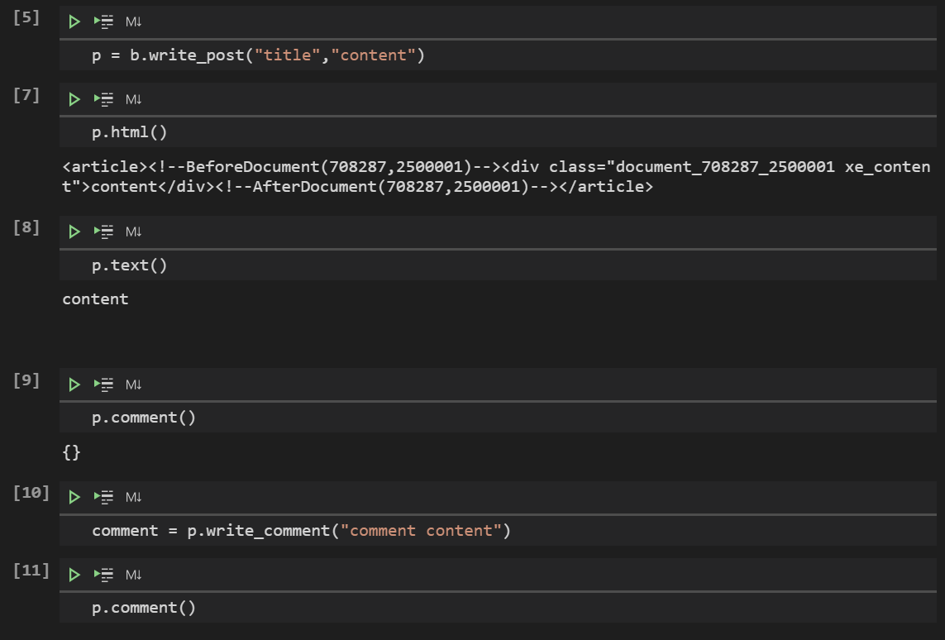
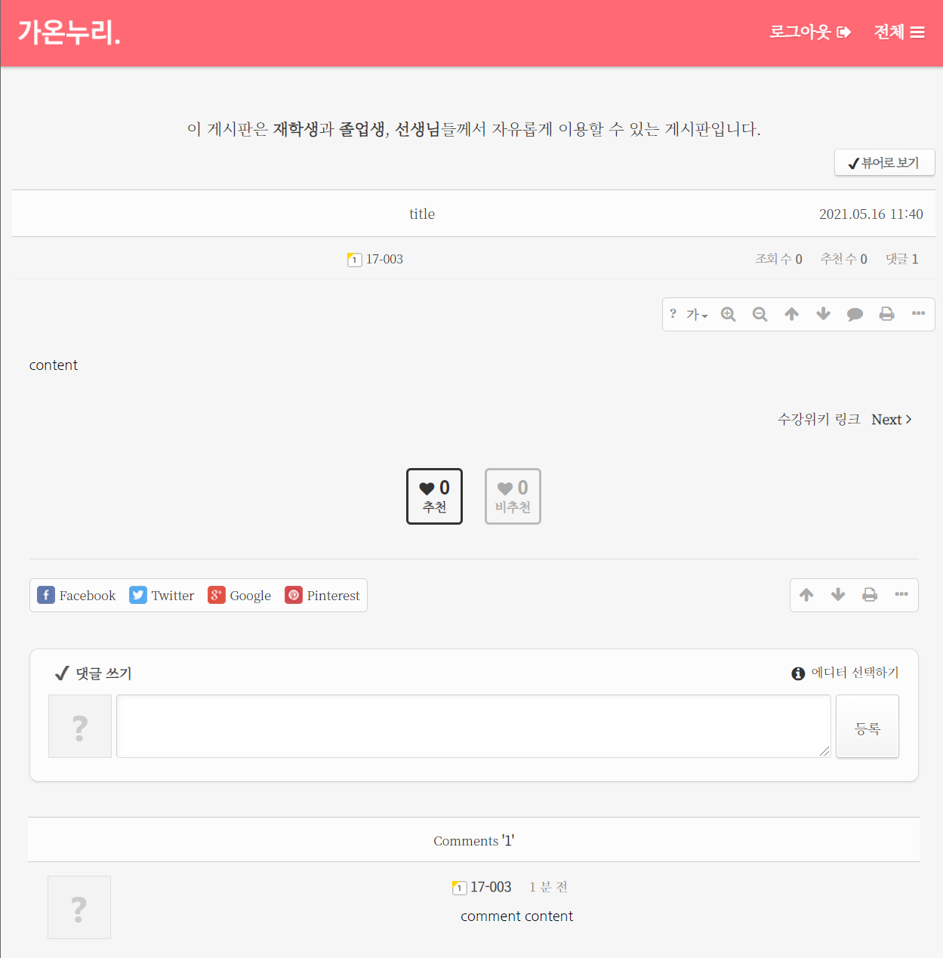
Demo

Slide 8
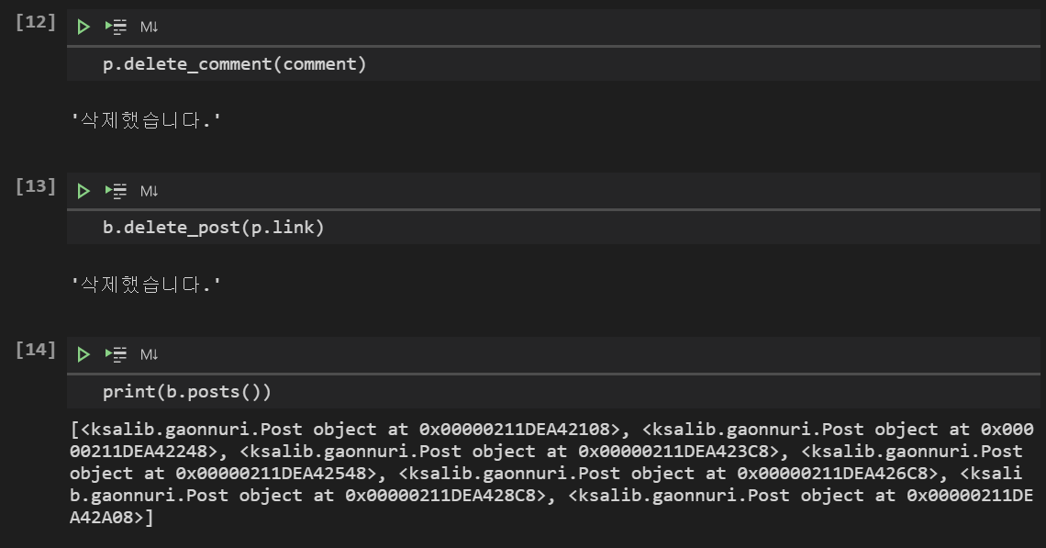
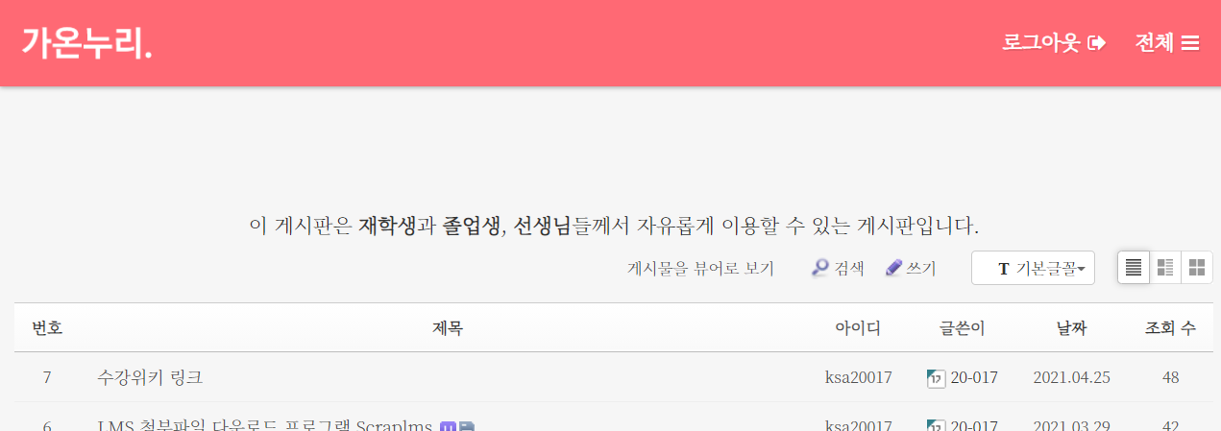
Demo

Slide 9
Demo

Slide 10
Demo
학사 사이트는 많이 완성되었는데 현재 터져버려서 데모를 만들 수가 없었습니다ㅜㅠ

