Slide 1
19-023 김유신
19-089 이호성

Slide 2
Pikachu volleyball

Slide 3
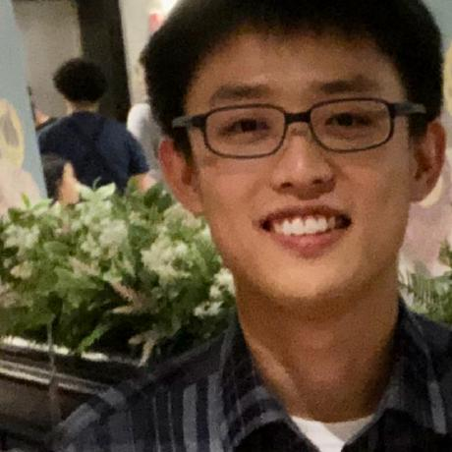
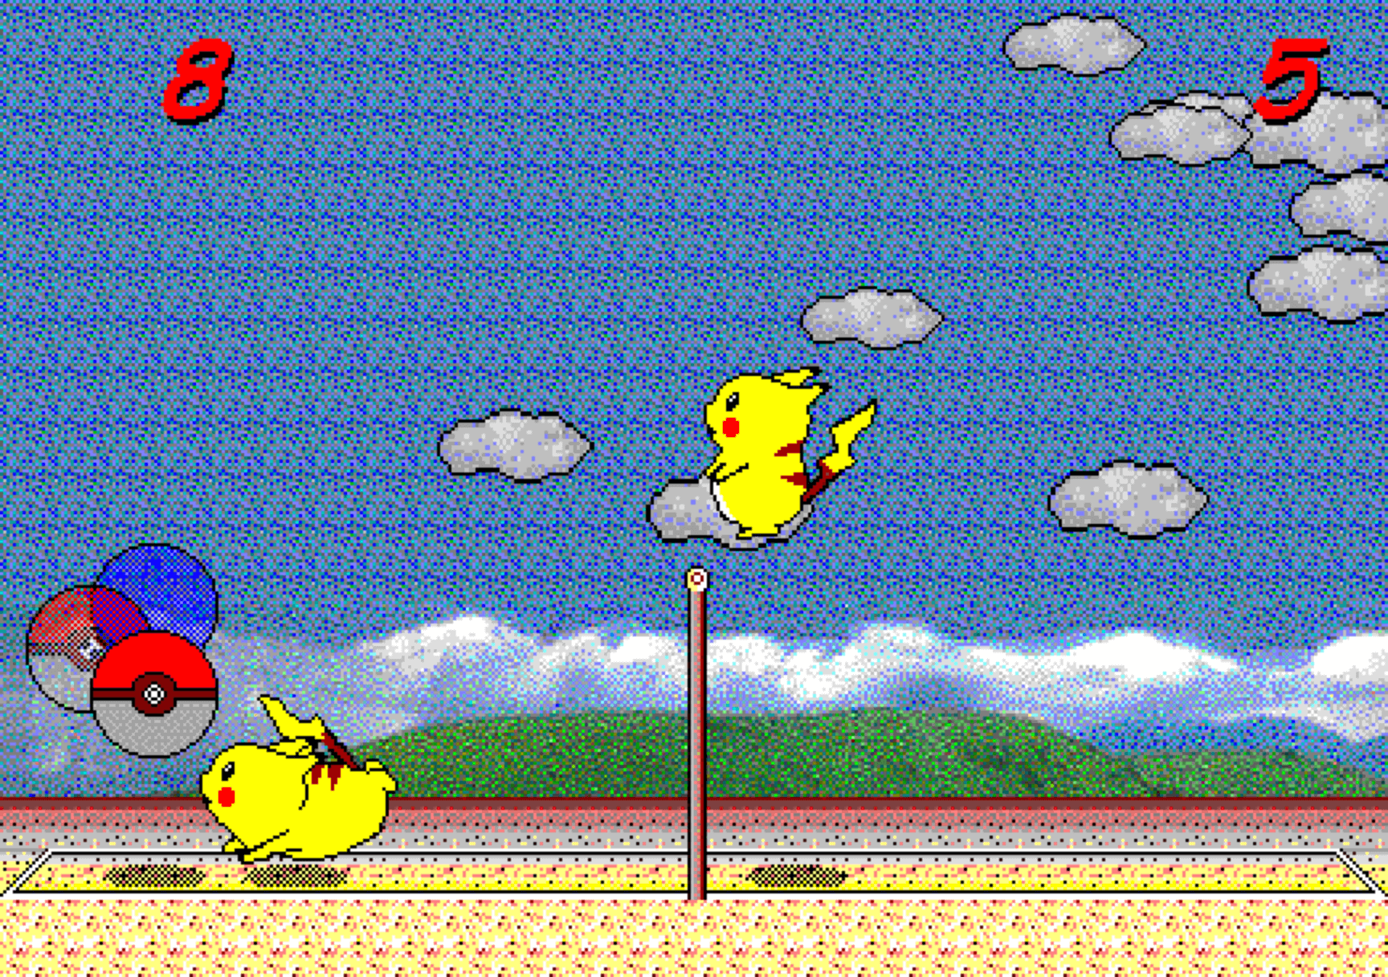
Starting Point (@gorisanson)
https://github.com/gorisanson/pikachu-volleyball

Slide 4
Getting approval

Slide 5
Everything is Javascript ㅠㅠ ;(

Slide 6
Addition, what can go wrong?

Slide 7
Banana?

Slide 8
Why we use Python

Slide 9
haha what the f*ck

Slide 10
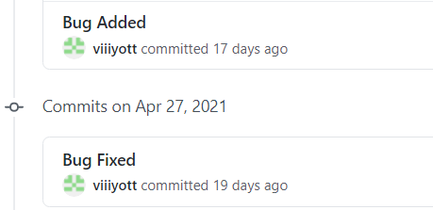
What we did
Convert the game from volleyball to dodgeball
Added Legendary AI (only 이창하 can defeat without bugs)
Tried to create a P2P version (Looking for volunteers)
Made the game symmetrical
Improved collision detection
A lot of bug fixes (and additions)

Slide 11
https://youtu.be/QeJ0hMs48zA

