Slide 1
WEBstudy - Minesweeper
21-017 김민우, 21-024 김예린, 21-079 이종현

Slide 2
WEBn
HTML
JavaScript
CSS

Slide 3
Minesweeper
지뢰찾기

Slide 4
TODO
Tab enter key → home.html to game.html
Record and show time spent
Flag mines by right click
User friendly design
Always resolvable without any luck

Slide 5
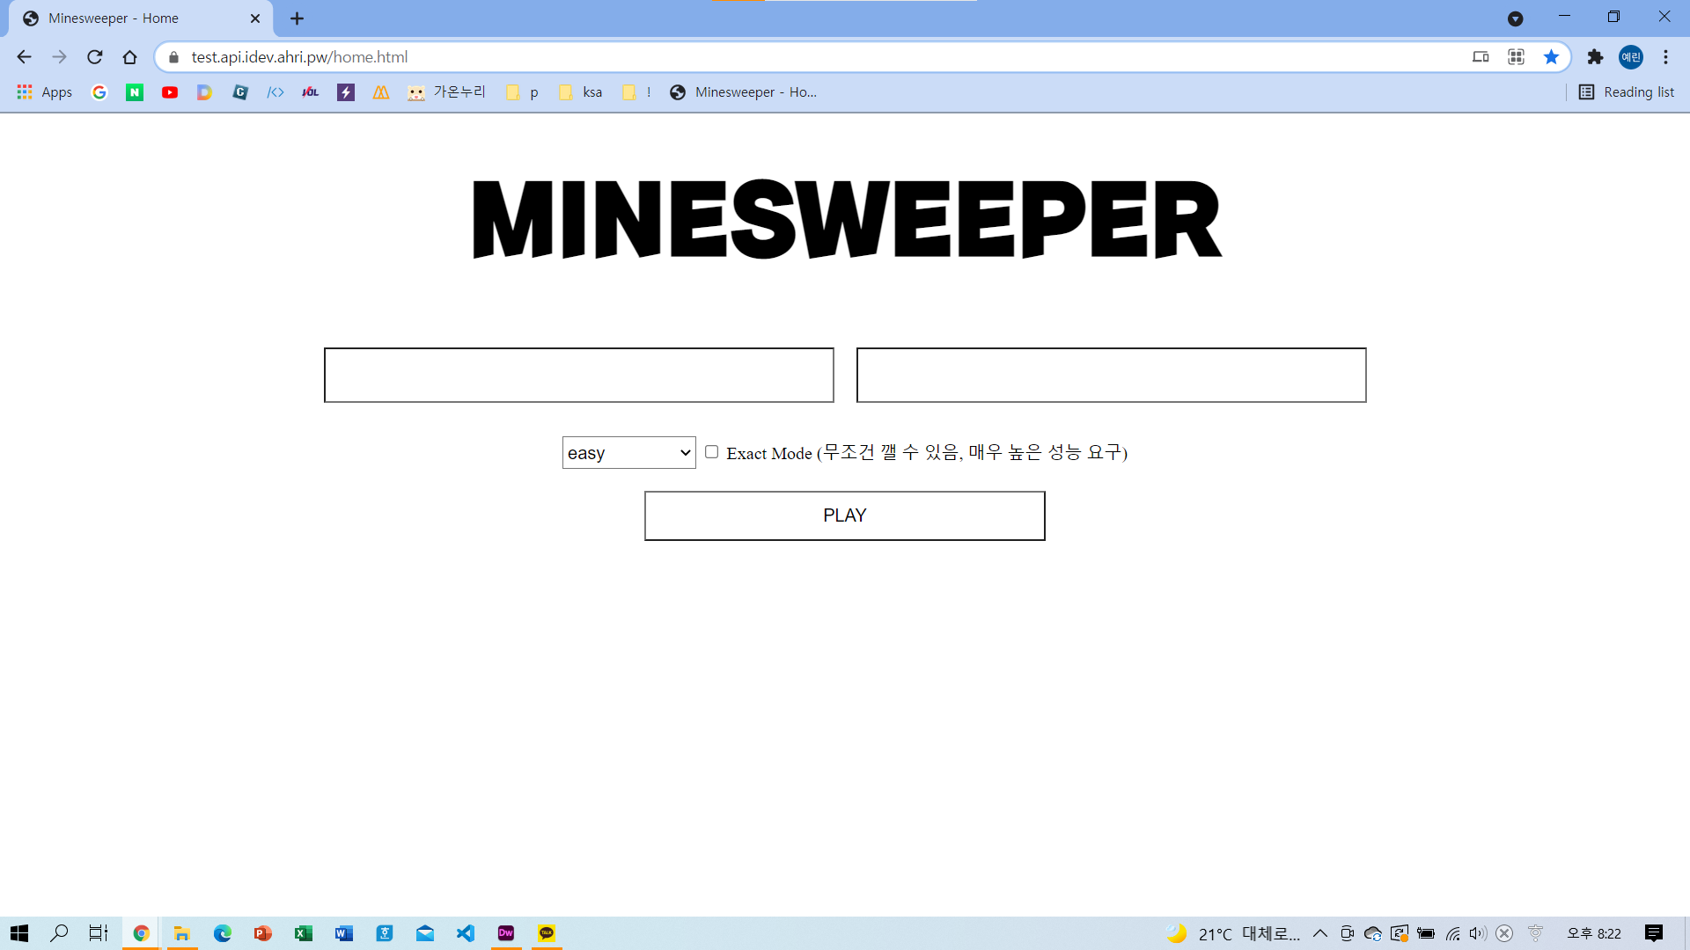
HOME

Slide 6
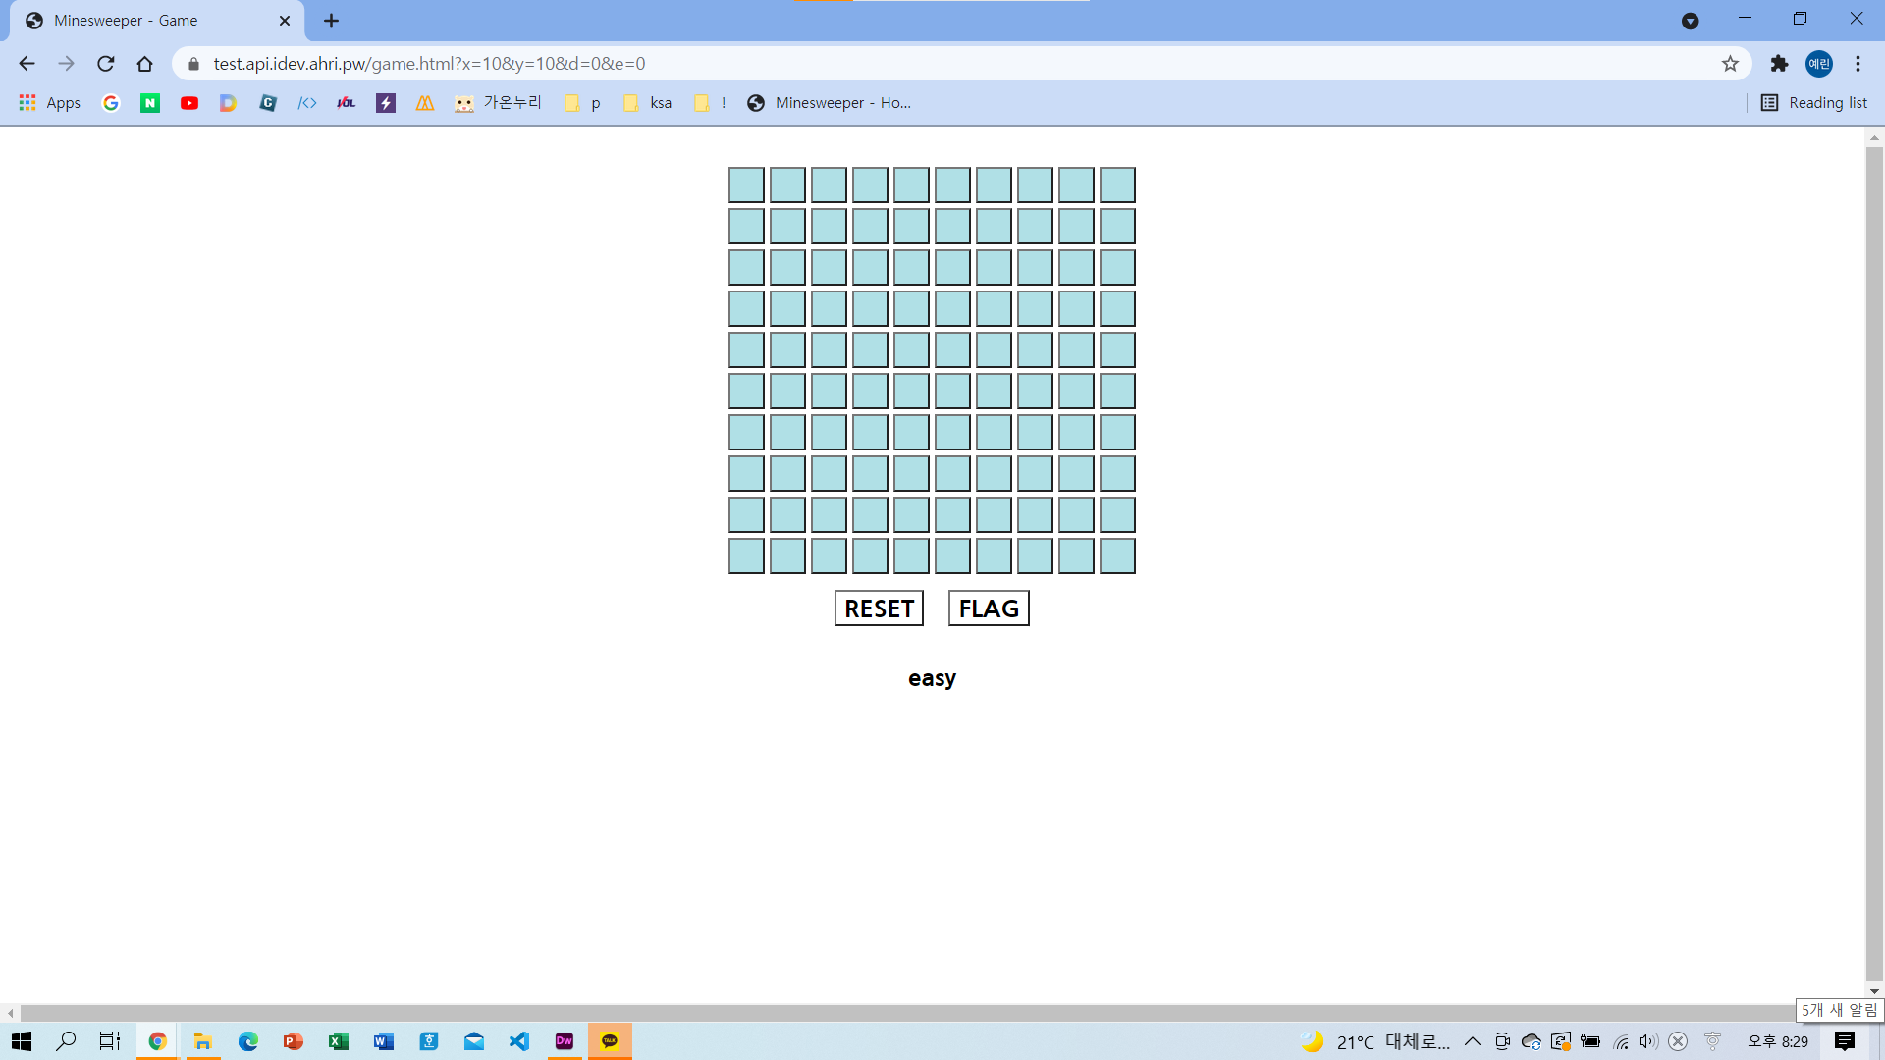
GAME START

Slide 7
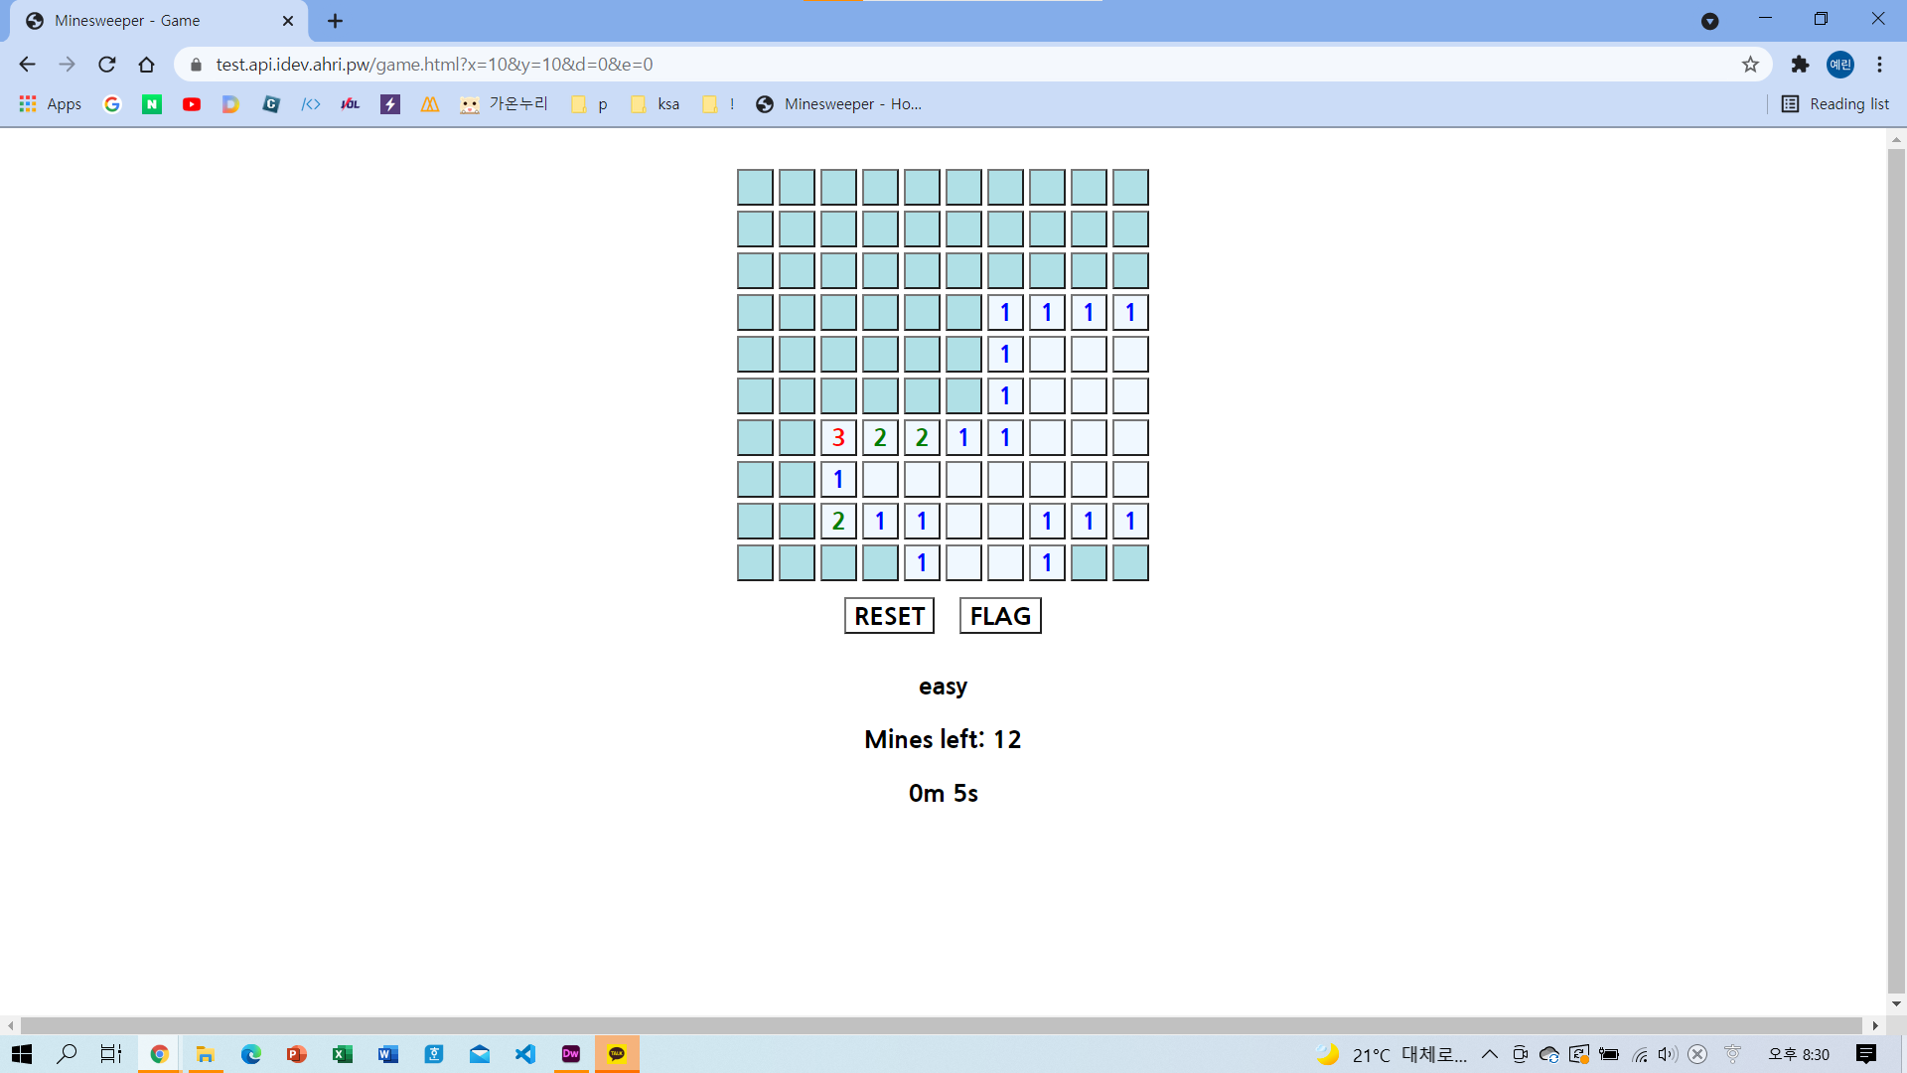
FIRST CLICK

Slide 8
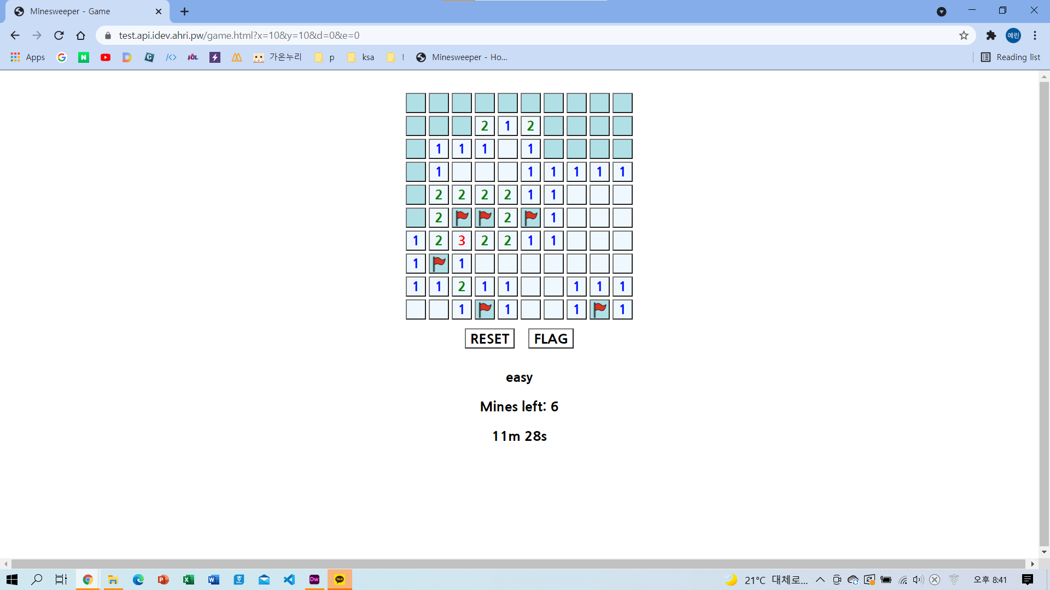
FLAG

Slide 9
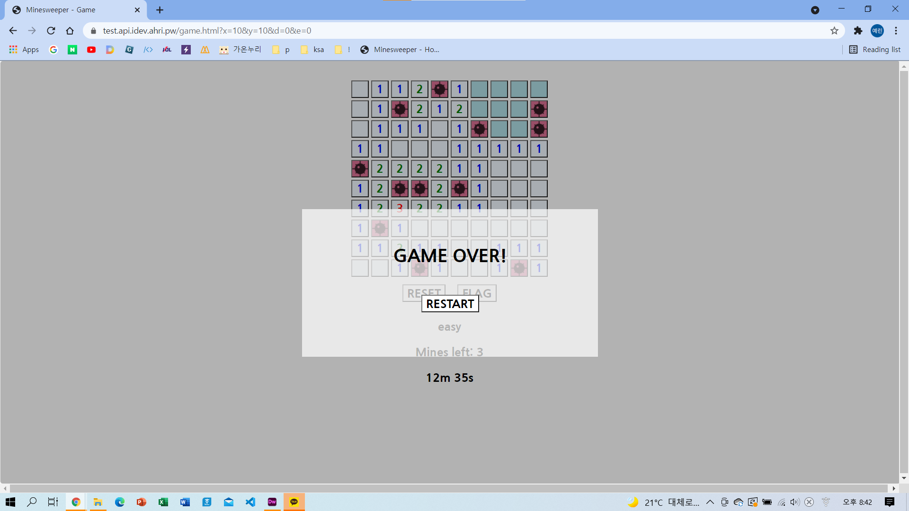
GAME OVER

Slide 10
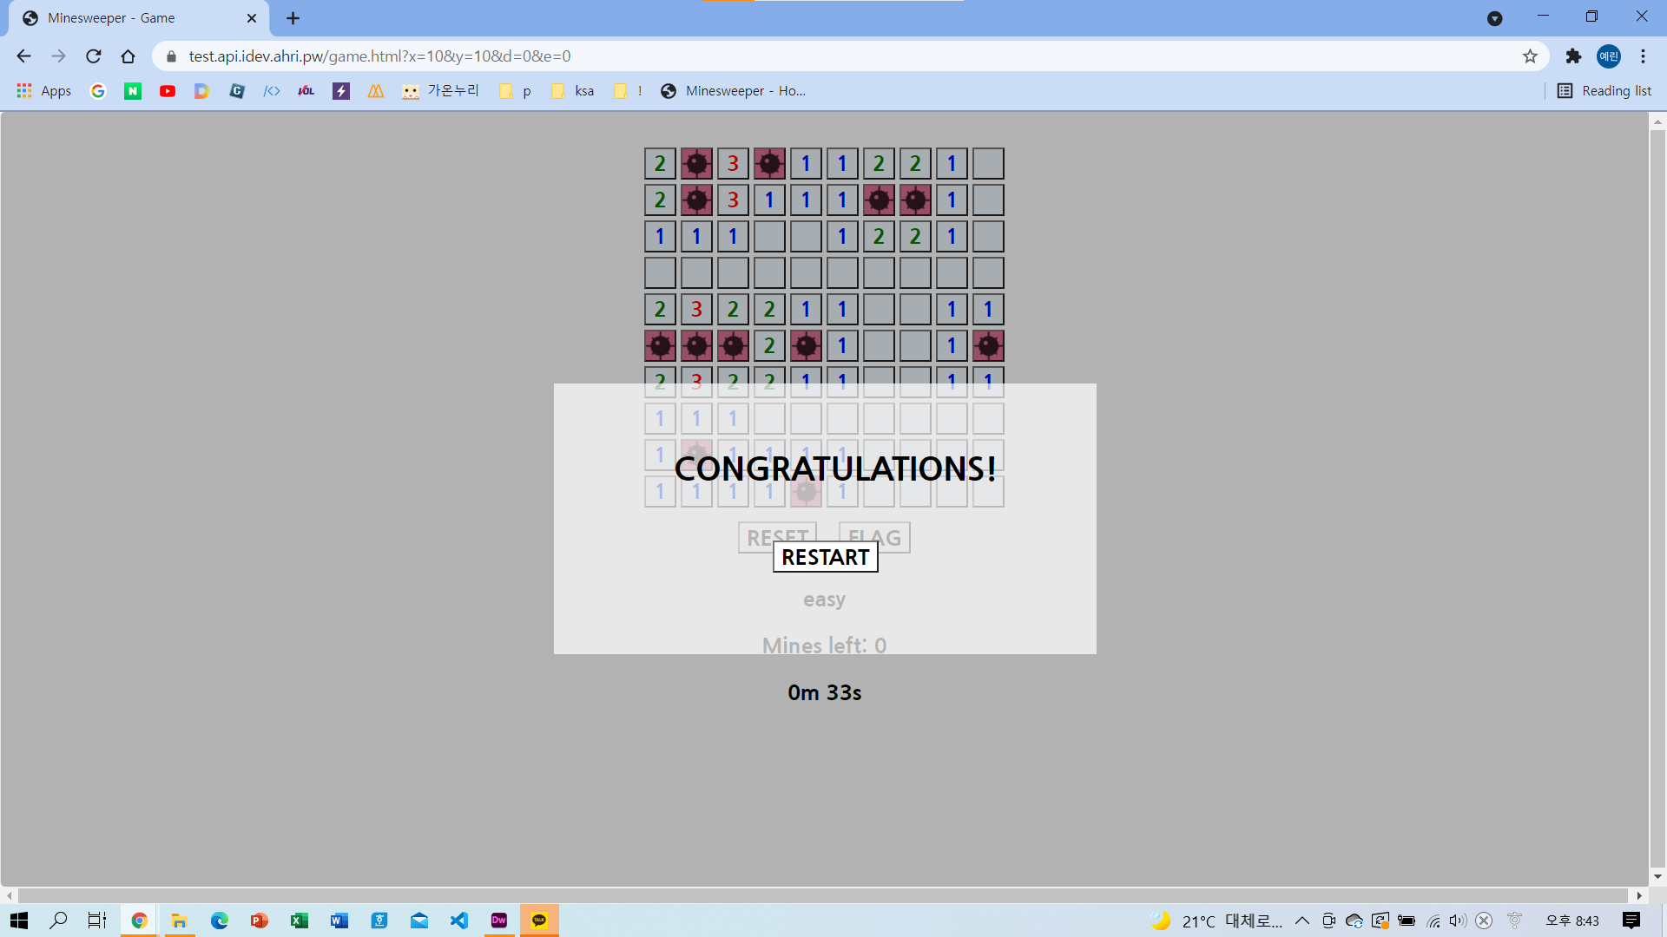
GAME CLEAR

Slide 11
game.html
x, y, d, e
home.html
redirect.js
home.js
home.css
game.js
game.css
minesweeper.js
bot.js

Slide 12
Home page
home.html
Stylesheet for home.html
home.js
home.css
Home button onclick event script
click시 home.html의 input값들을 받아 처리한 뒤 redirect.js로 넘김

Slide 13
x: mine map x size
y: mine map y size
d: difficulty (0~3)
e: exact mode (0 or 1)
Query parameters
x, y, d, e
functions for redirect with url parameters
setUrlParams(params, url) → redirect to url with params
redirect.js
setUrlParams({a: 10, b: 1000}, ‘home.html’)
ㄴ redirect to https://ex.com/home.html?a=10&b=1000
getUrlParams() → return params
getUrlParams() at https://ex.com/game.html?x=15&y=15
ㄴ return {x: 15, y: 15}

Slide 14
Game page
ㄴ body가 없음 : script에서 html을 모두 생성함
game.html
Visualizing minesweeper data
init functions
var ms: minesweeper map data & processing functions
onclick, refreshview, etc.
game.js
game.css
minesweeper.js
minesweeper data processing core
bot.js
minesweeper auto solving bot

Slide 15
game.js

Slide 16
Tab enter key -> home.html to game.html
ㄴ onkeyup event
Record and show time spent
ㄴ setInterval()
Flag mines by right click
ㄴ onrclick_handler
(shift+click is also available)

Slide 17
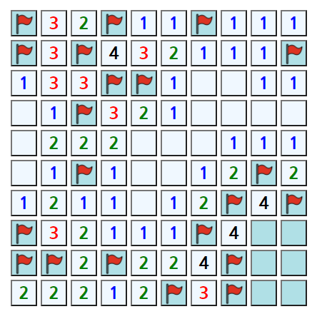
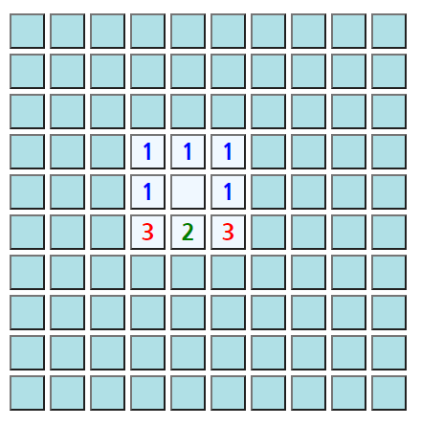
Why bot.js?
???????????????????????????????????????????????????????????????????????????????????????????????????????????????????

Slide 18
Bot.js (1)
1
1
1
===
-1
-1
-2
1
3
2
-2
-2
-2
0
1
1
0
-2
-1

Slide 19
Bot.js (2)
?
1
?
=>
?
?
?
3
2
?
1
?
?
?
?
?
?

Slide 20
Strategy 1
?
?
=> Open all adjacent blanks
?
0
?
?
?

Slide 21
Strategy 2
=> Put mines in all blanks
3

Slide 22
Strategy 3
=>
1
2
1
1
2
1

Slide 23
Strategy 4
=>
1
2
2
1
1
2
1
1

Slide 24
Strategy 5
=>
2
1
2
1

Slide 25
Strategy 6
=>
1
1
1
1

Slide 26
Try it!
minesweeper.bfy.kr

